Slide 2
Rational Order of Laboratory Tests in Cardiovascular Diseases
Sedighe Sadat Ghorashi. MD. Family Medicine

Slide 3
Introduction
populations age worldwide increases
more patients survive acute cardiovascular and cerebrovascular events
incidence of CVD risk factors continues to increase
the burden on family physicians to identify and effectively manage CVD will continue to escalate dramatically.

Slide 4
Atherosclerosis Risk Factors
dyslipidemia
HTN
impairments in glycemic control
age
family history
cigarette smoking
obesity
systemic inflammation

Slide 5
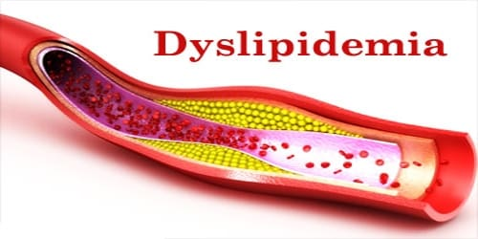

Slide 6
dyslipidemia
fasting(9-12 h) lipoprotein profile :
total cholesterol
LDL cholesterol
HDL cholesterol
Triglyceride
should be obtained at least once every 5 years in adults age 20 yrs and over
the average of two measurements done 1 to 4 weeks apart while the patient is consistently following a low-fat diet

Slide 7
ASCVD PREVENTION (atherosclerotic cardiovascular disease)
American College of Cardiology/American
Heart Association (ACC/AHA) guideline 2018
Primary & Secondary prevention
Therapeutic lifestyle changes (TLC)
Statin therapy

Slide 8
Secondary Prevention in Patients With Clinical ASCVD

Slide 9
Very High-Risk of Future ASCVD Events

Slide 10
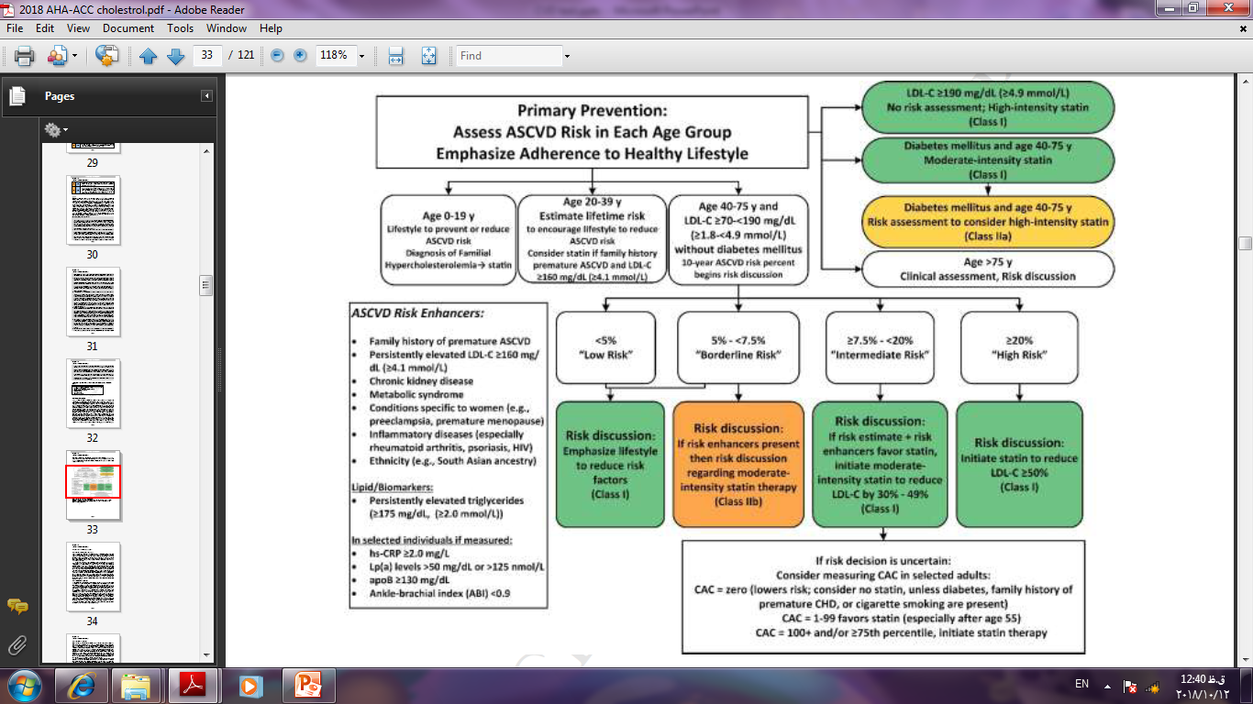

Slide 11
Online assessing
PCE Risk Score
Application : ASCVD risk estimator
https://tools.acc.org/ASCVD-Risk-Estimator-Plus
Screening Tests for Adults Recommended by the U.S. Preventive Services Task Force(USPSTF)
Electronic Preventive Services Selector (ePSS)
http://epss.ahrq.gov/PDA/index.jsp

Slide 12
Statin therapy
4 groups:
Clinical ASCVD
LDL ≥ 190 mg/dl
DM ≥ 40 y with LDL ≥70
ASCVD risk score ≥ 7.5%

Slide 13
LDL Calculation in Hypertiglyceridmia
Friedewald formula:
LDL-C = (TC) – (triglycerides /5) – (HDL-C)
If serum TG ≥250 , Chol is not accurately measured by lab test.
So what do we do?
Non HDL Chol = total Chol – HDLc
LDL ≈ non HDLc - 30

Slide 14
Example
آقای 39 ساله با آزمایش زیر مراجعه کرده است. سابقه بیماری خاصی ندارد. BMI=34
FBS = 110
TG = 329
Chol = 287 , LDL= 167 , HDL = 54
TG≥250
Non HDLc = 287 – 54 = 233
LDL = 233- 30 = 203 LDL ≥ 190
علاوه بر اصلاح سبک زندگی، اندیکاسیون شروع درمان با استاتین دارد

Slide 15
Patients on Statins
Baseline measurements liver function tests (i.e., ALT or AST), CK . (hepatic steatosis)
monitoring of liver enzymes is not necessary
Mild elevations in serum transaminase levels usually resolve spontaneously.
SGPT ≥ 3 x ULN Liver toxicity
creatine kinase ≥ 10 x ULN , cr rises
myopathy /rhabdomyolysis
Hypothyroidism & vit. D deficiency increase risk of myopathy

Slide 16
Follow up (statin therapy monitoring)
Adherence to changes in lifestyle and effects of LDL-C–lowering medication should be assessed by:
measurement of fasting lipids and appropriate safety indicators 4 to 12 weeks after statin initiation or dose adjustment
every 3 to 12 months thereafter based on need to assess adherence or safety

Slide 17
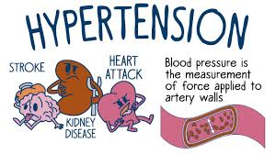

Slide 18
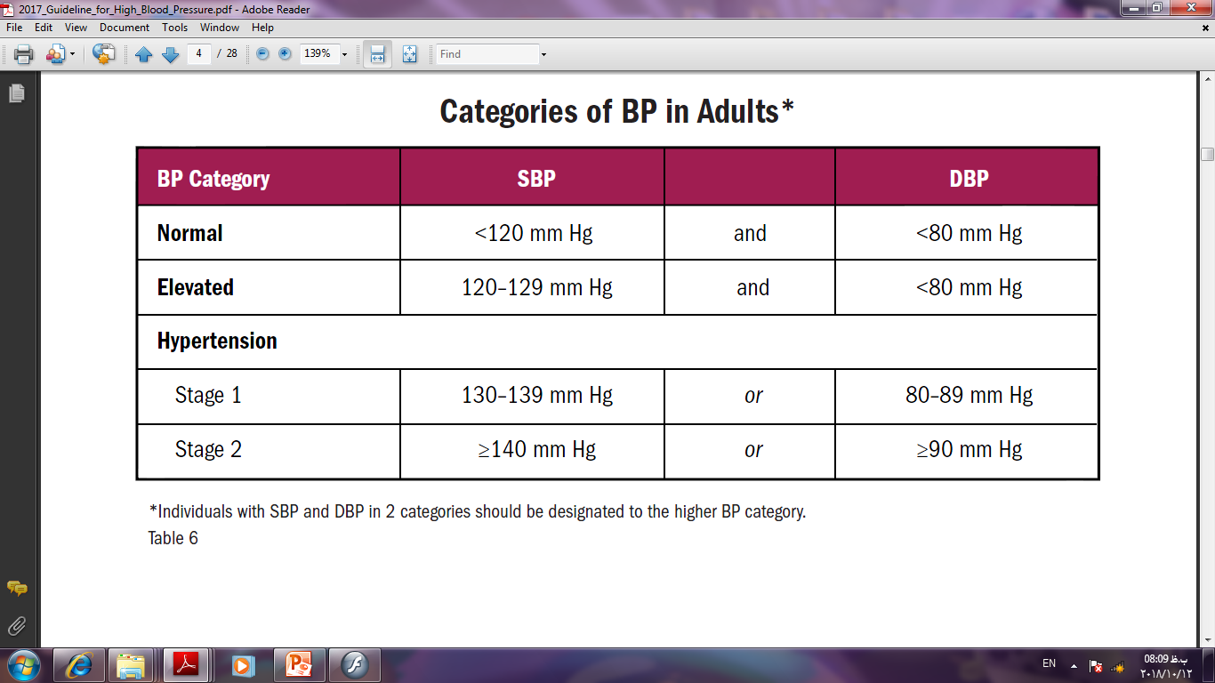
Hypertension (2017 ACC/AHA guideline)

Slide 19
Confirm htn diagnosis (White Coat htn or Masked htn)

Slide 20
Laboratory Tests for Primary Hypertension

Slide 21
Treatment monitoring (ACE inhibitors and ARBs)
Prior Rx : serum base Cr
2 weeks after initiation : recheck Cr , K
An increase in serum creatinine of up to 30% is acceptable
Hyperkalemia monitoring
Monitoring
Cr ,urea, Na , K 1-2 times /year
If eGFR < 60 , ACR ≥ 30 1-4 times /year

Slide 22
Thanks for your attention

